Slide 1
Denver Health Pediatric Emergency Department and Urgent Care Resident Orientation

Slide 2
Welcome
Welcome to the Denver Health Pediatric Emergency Department and Urgent Care. We hope you will find your rotation to be highly educational and also fun. This orientation presentation was put together to help get residents up to speed with the processes and also to clarify expectations for the for your rotation.
If you need to contact someone please email or call
Patti Ziegler (Administrative Assistant) for all general questions or questions regarding the schedule
patricia.ziegler@dhha.org
Phone: 303-602-5151
Matt Rustici MD (Resident Education Director)
Matthew.rustici@ucdenver.edu
Cell: 720-670-9024
You are expected to contact the attending working in the Emergency Department/Urgent Care in addition to your chief residents if you are unable to work one of your scheduled shifts due to illness or emergency.

Slide 3
Welcome
The Pediatric Emergency Department and Urgent Care was created in 2008 when the PUC (Pediatric Urgent Care) which was staffed by Pediatricians and the DH ED (who saw all emergent pediatric patients) were combined.
We are all very focused on providing top-tier patient care, which we practice in 3 ways:
A timely and efficient visit (the biggest driver of patient satisfaction)
High-quality, evidence-based care
A compassionate child/adolescent friendly experience for patients

Slide 4
Pediatric Emergency Department and Urgent Care Demographics
We see ALL patients age 0-19 with Urgent Care or Emergency Department complaints
Exceptions:
“Trauma Activations” who are 16-19 years old go to the Trauma side of the ED, however, ALL “Trauma Alerts” come to the Pediatric Emergency Department
Alert = could become sick, Activation = is already really sick
Pregnant patients who have a gestational age >14 weeks with pregnancy related complaints should go to OB screening unless brought in by ambulance
Immediate family members of a pediatric patient who are >19 years old can be seen by ANY resident but there must be an EM attending who approves checking in these patients and who is willing to staff the patient.

Slide 5
Pediatric Emergency Department and Urgent Care Demographics
Average 65-90 patients per day
Average length of stay for discharged patients is 127 minutes (goal <120 min)
Average time from bed requested to ED departure for admitted patients is 98 minutes
Average time in waiting room 11 minutes

Slide 6
Goals of Resident Experience in the Pediatric Emergency Department and Urgent Care
Learn how to determine sick vs not sick
Develop your clinical reasoning framework for pediatric patients in the ED/Urgent Care setting (worst dx first, don’t do it if it won’t change your management, ABC’s of resuscitation, etc.)
Practice communication techniques that let you quickly bond with patients and efficiently explain diagnoses and treatment plans
Perform medical procedures
Give top-notch patient care that addresses the medical, social and parenting needs of the family you are seeing

Slide 7
Optimizing the Patient’s Experience
When caring for patients ask yourself the following questions with each encounter
Did I address the fear/anxiety that pushed this parent/teen to come to the ED?
Did I make sure everything was done to ensure this child/teen gets the best care/treatment/support that they need?
Try to avoid saying “this is not an emergent issues” and instead do what is in the best interest of the patient
Did I do everything I could to expedite the care of this patient?
Patients hate being in the ED any longer than they have to be
Did I keep this patient/family informed of the plan during their stay and did they actually understand what I told them?
Not feeling adequately informed of the plan/expected timeframe is the biggest complaint of patients

Slide 8
Typical Patient Visit
Many DH patients arrive via city bus which is important to consider prior to discharge late at night.
Patients are briefly screened by a tech or nurse in the waiting room.
They are then sent directly to a patient room (if space is available).
If there are no open beds, a triage nurses will complete the MSE (Medical Screening Exam) in the waiting room.
Patients in the waiting room are called back based on acuity and time waiting.

Slide 9
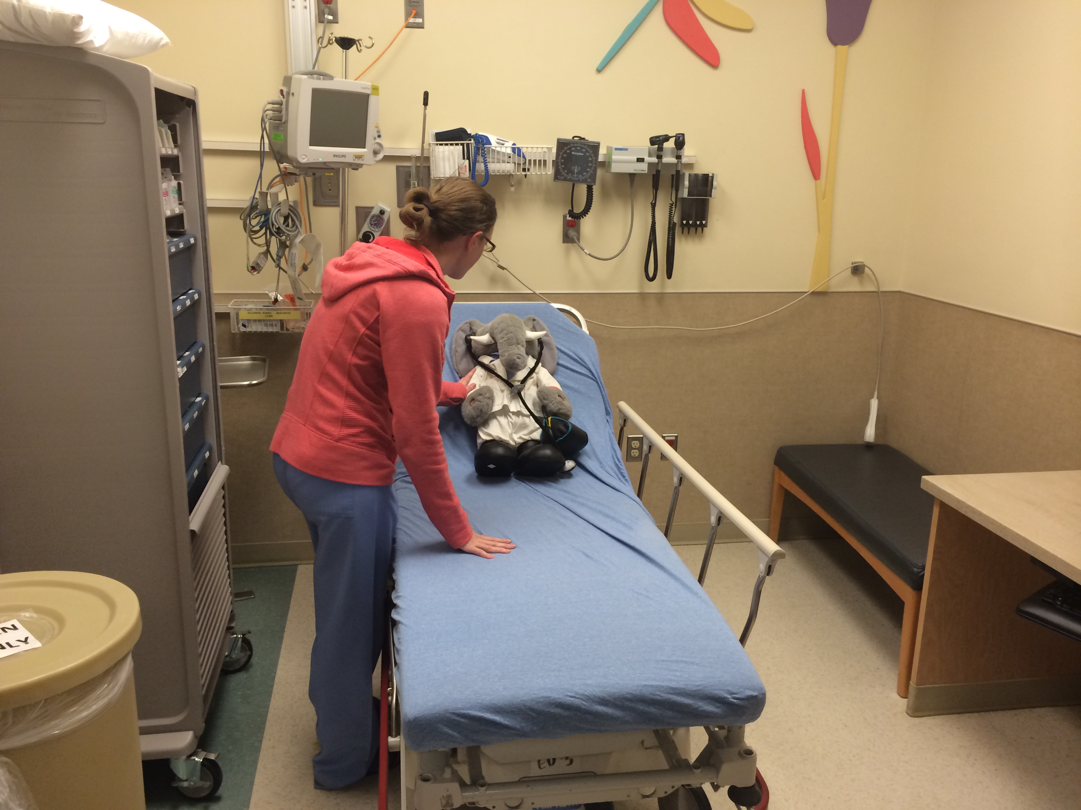
Physician evaluation of the patient
At the time the patient gets to a room, you should also enter the room if you are free, but please remain quiet and let nursing and/or registration complete their work UNINTERUPTED.
Be sure to introduce yourself when you walk in the room and explain that you are going to let the nurse finish their MSE before asking more questions.

Slide 10
EMS Patents
The senior resident is expected to meet all ambulance crews and hear the signout. If the senior resident is not available, a junior resident or attending should meet the EMS crew to hear signout as often as possible.
If an EMS patient appears sick, examine them immediately while nursing is obtaining vitals and ask for help if needed.
Trauma patients taken to a “Front Room” should have a head-to-toe exam (Primary Assessment) called out (i.e. spoken loudly) by a junior resident after EMS signout. Speak so nursing can hear you. If you have never done this, ask a senior resident to walk you through it before you have to do it live.
Junior residents from ALL specialties are expected to see front room trauma patients (not just EM residents)

Slide 11
Guidelines for Signing up for Patients
If you are busy and there are multiple patients to be seen, please choose the patient with the most acute triage level (1 = most acute, 4 = least acute).
If there are multiple patients with the same level, chose the patient with the longest waiting time.
NEVER sign up for a second patient prior to seeing the first patient. Once you have seen/examined a patient AND staffed the patient with a senior resident or attending, you can sign up for a new patient.
When senior residents are seeing patients individually, they should try to preferentially pick up patients with low resources needs when possible (ie; patients who can been seen quickly with minimal need for prolonged procedures or repeat exams/discussions).

Slide 12
Guidelines for Signing up for Patients
Try to chose patients with illnesses you won’t see as much in other areas of your training
Peds Residents: pick up OB patients, ingestions, pt’s needing US and trauma and sick patients
EM Residents: pick up rashes, small babies and sick patients
FM Residents: pick up as many patients as you can with as many different chief complaints
Junior residents are expected to be capable of managing 3-6 patients at a time
Senior residents should help junior residents troubleshoot inefficiencies and also should help complete paperwork/orders/discharge instructions as necessary.
Do not “save patients” for the Advanced Practice Providers (APPs or mid-levels). They will see patients from least acute to most acute and do not have a quota of a certain number of patients to see per shift in the ED.
APPs primarily will see patients in rooms 4-9 but residents are also expected to see patients in these rooms if there are no patients to see in the rest of the department.

Slide 13
Physician evaluation of the patient
You are encouraged to finish as much documentation as possible as you go, but if the Pediatric Emergency Department and Urgent Care is crazy, please start any work-up of existing patients before completing your whole note.
The APPs will also see patients and will select patients from least acute to most acute. Do not “save” patients for the APPs. Moving patients efficiently through the ED is more important than dividing the patients among provider, so please see patients if you are ready.

Slide 14
Key Components of the Resident Note
Resident notes should be more pertinent then H&P’s written for patients being admitted by a hospital service.
This means that information can be written in short hand and focus on aspects of the history and physical that are pertinent.
Due to billing needs, there are a few aspects of documentation that must be in ALL resident notes.
A chief complaint is listed explicitly
HPI must include onset, duration, severity, alleviating/exacerbating factors, and associated symptoms related to the chief complaint.
ROS must have either “negative” or a symptom (ie; cough) for all 10 systems.

Slide 15
Key Components of the Resident Note
ED Course should detail what happened to the patient and all test results.
There is no standard “Assessment and Plan” section of the Epic note. Please write something at the bottom of your note.
Plan should include meds you are sending the patient home with.
MDM (medical decision making) should be documented on all patients stating what other dx you considered, but it can be brief.

Slide 16
Interpretation Services
All patients who speak English as a second language should be offered a medical interpreter. If they decline the interpreter this should be documented in your note.
A live Spanish interpreter is available from 7:30am-6pm or 11:30pm depending on the day. Schedules also vary on holidays and weekends. Dial x23347 or x63222 for Vocera and ask for “Spanish Interpreter”
Sign language interpretation is also available (contact charge nurse to arrange)
For all other languages or during non-business hours, dial x66666 to reach a Language Line phone interpreter. The 6 digit access code is 745300.

Slide 17
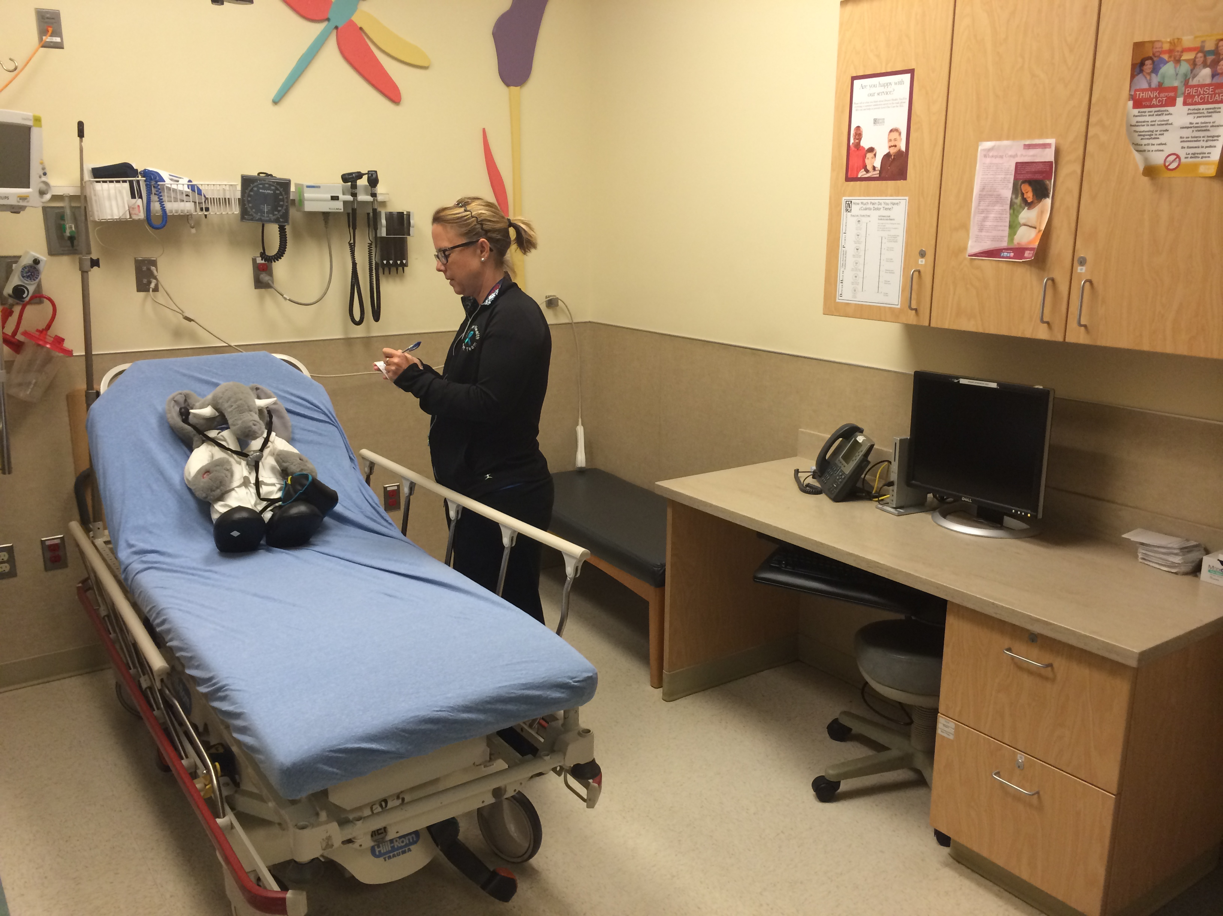
MSE
An MSE (Medical Screening Exam) is performed by nursing. MSE’s include a brief HPI, PMH, Meds, Allergies, and Immunization status. Nursing also takes initial vitals and does a basic physical exam.
Please do not delay the nurse in anyway from finishing their assessment or obtaining vital signs
Nursing is also able to complete many “nurse initiated standing orders” after the MSE including anti-pyretics, decadron and xrays.
ALL orders needed after the patient is triaged must be placed by a provider.

Slide 18
Nursing Roles
Nurses wear blue scrub tops.
They typically have 2-5 patients.
Almost all of our nurses are highly experienced working in a pediatric ED/UC and most have worked in the Pediatric Emergency Department and Urgent Care for many years. They have a wealth of knowledge/experience and are amazing resources, so please ask them for help early and often.
We have one charge nurse who assigns patients to rooms, covers nurses at lunch, maintains patient flow and helps with critically ill patients. They are great resources for most questions you have.
Charge nurses do not typically have patients assigned to them.

Slide 19
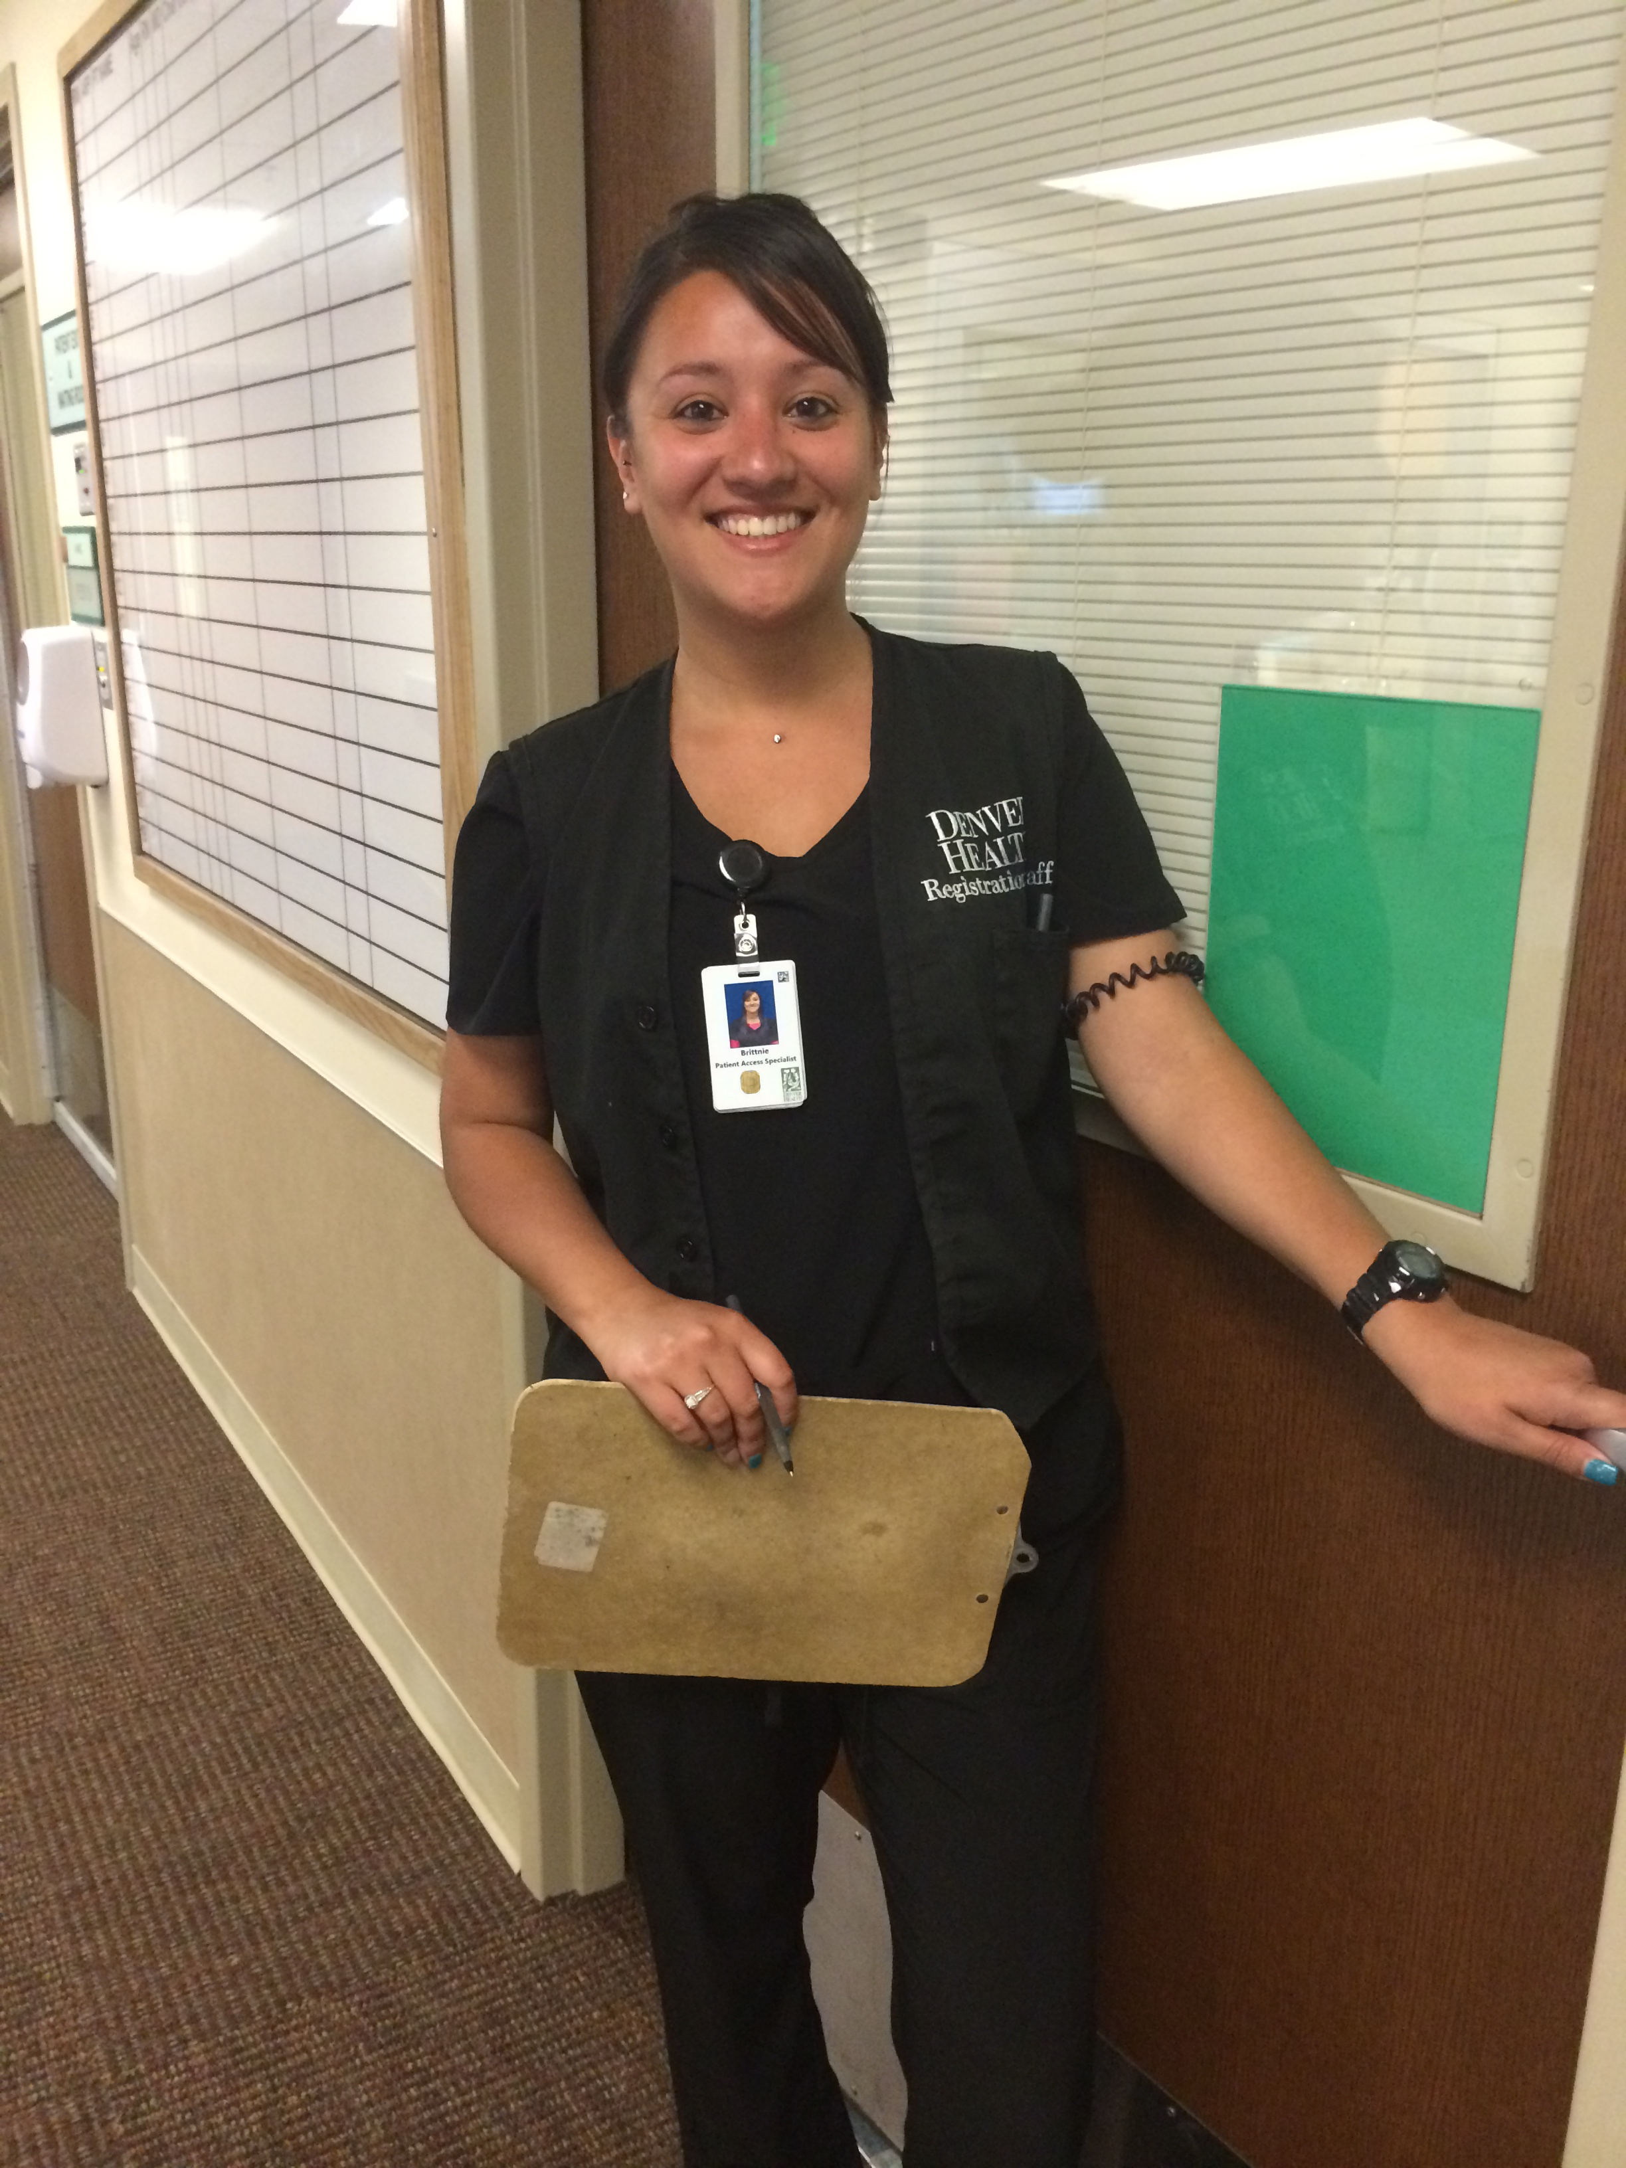
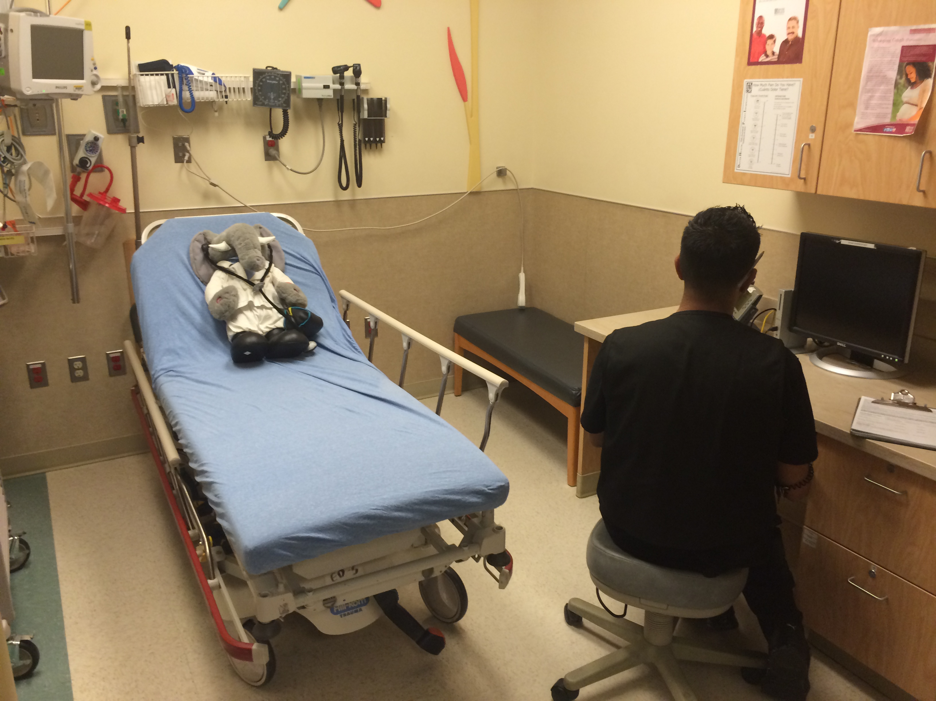
Registration
Registration clerks wear black vests and collect insurance information and reportable data on injuries. Registration takes about 5-10 min, but there are only 1-2 clerks at any time.
You are welcome to enter the room while registration is working. In the past, some registration clerks have been intimidated by physicians, so encourage them to finish their work if you are in the room together.

Slide 20
Staffing the Patient
Ideally all patients seen by junior residents (1st and 2nd years) should be staffed with the senior resident. Once a patient has been staffed with the senior resident, the junior resident should sign up for an additional patient and complete their note if time allows.
The senior resident has discretion on whether it is educationally beneficial for them to staff Level 4 patients seen by junior residents on a case-by-case basis
The senior resident is then expected to see the patient and briefly staff the patient with an attending prior to ordering invasive testing. Senior residents should feel comfortable ordering initial medications and non-invasive testing upon seeing the patient and can treat patients in pain with IV or PO meds as needed prior to staffing the patient.

Slide 21
Staffing the Patient
After staffing the patient with an attending, the attending is expected to see the patient prior to discharge (for both billing and patient care reasons).
Overnight, the senior resident is given more flexibility on managing patients and can initiate work up for patients and then consult with the cross-covering EM attending.
If the Pediatric Emergency Department and Urgent Care is very busy and there is only 1 junior and 1 senior resident, the senior resident is expected to see patients at the same time they are staffing. If the senior is unavailable, junior residents should staff directly with an attending to keep patient flow moving and the senior should be briefed on the patient when they are available.

Slide 22
Staffing the Patient
Senior residents should ask the attendings on shift whether they would like the senior to write short notes on the junior charts. Seniors must write a full note on all medical student patients.
At the current time due to RRC requirements, all patients seen by an EM resident of any level must be staffed with the EM or PEM attending. EM residents are strongly encouraged to ask Pediatricians as many questions as possible to learn about different approaches to pediatric patients in the ED.
All junior residents of all specialties are expected to staff with the senior resident regardless of the senior resident’s specialty.
Pediatricians are credentialed to staff all patients from 0-19 years old except major trauma patients brought in by ambulance.

Slide 23
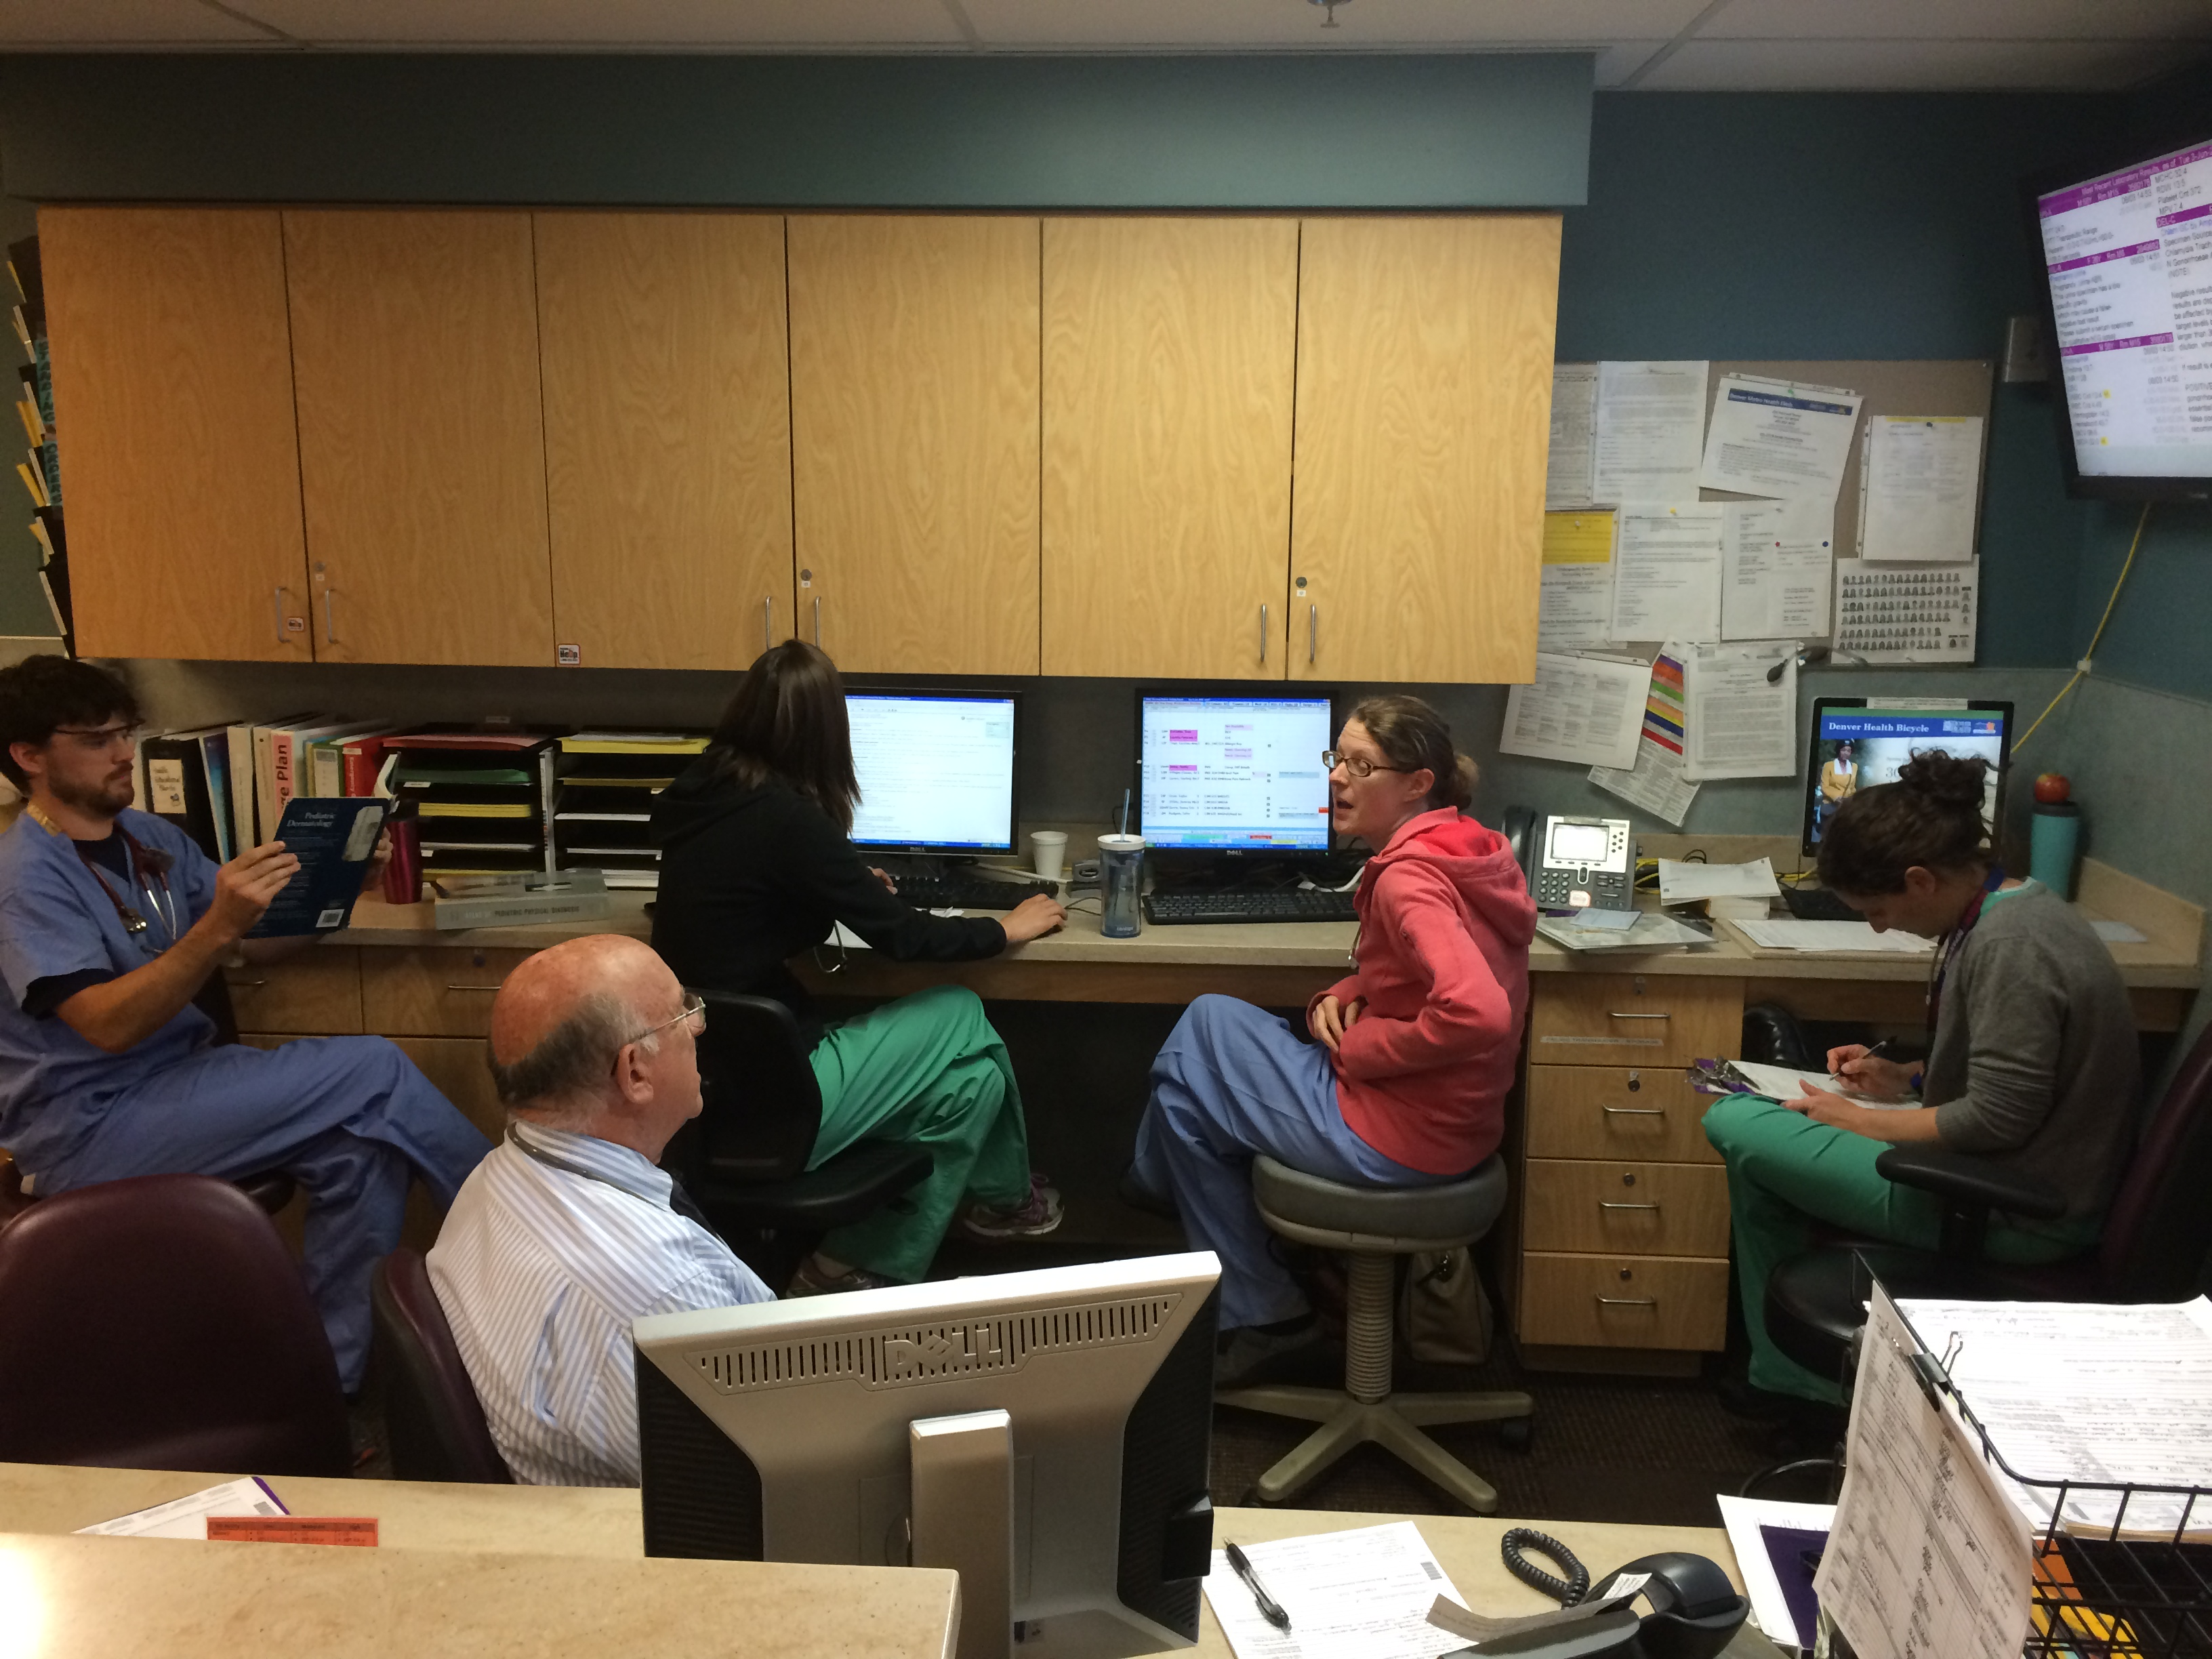
Senior Resident at resident computer
Resident Computers
Pediatrician’s workspace
Pediatrician’s workspace
Junior Residents
PEM/EM Attending’s workspace

Slide 24
Physician Completed Orders
For bacterial cultures, wet mounts, GC/CT swabs and CSF studies, physicians collect the samples and should ask nursing for help when sending it to the lab (nursing will help print stickers and scan the patient’s wrist band)
CSF studies should be carried to the lab by hand (find a tech who can walk them down).

Slide 25
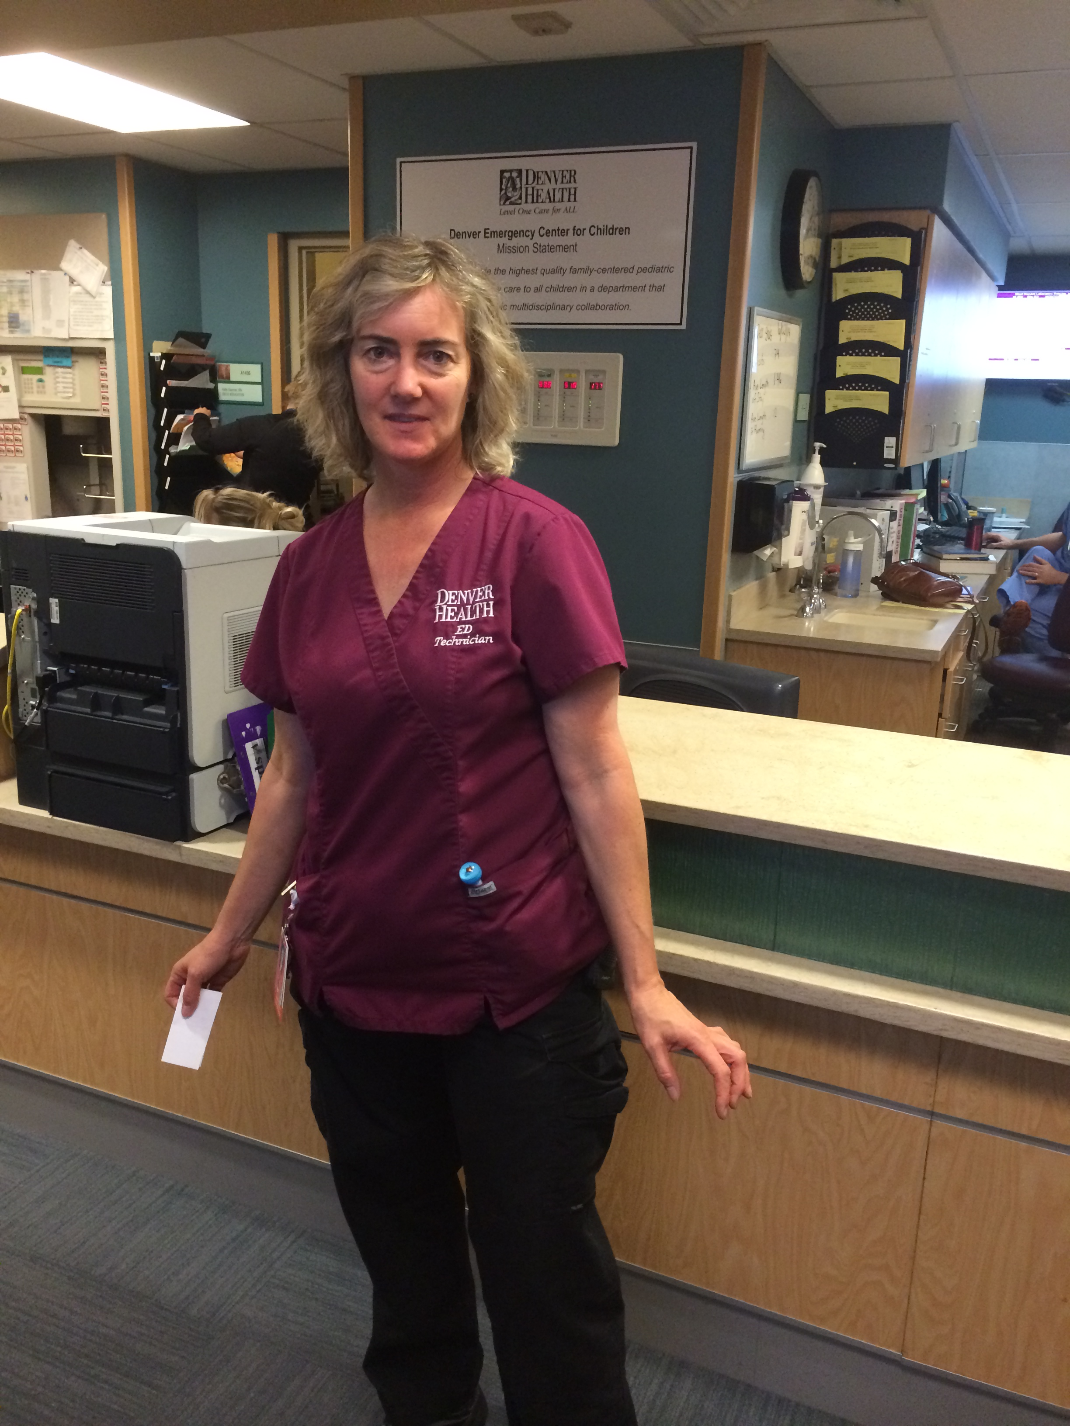
Tech Completed Orders
ED techs wear maroon scrub tops and are the glue that holds the ED/UC together.
They can get you anything you need.
Ask techs to irrigate wounds, hold for procedures, deliver CSF fluid and splint fractures.
Techs do not have Pyxis access and cannot dispense medications, but they can repeat vitals.
Lori Hartstock

Slide 26
Calling Consultants
Please place an order for “inpatient consult to ________”.
The clerk should page all consultants. Please ask them if you are calling another specialty.
Ask one of the attendings whether you should have Children’s paged or one of the consultants at Denver Health.
When you call consultants, we recommend discussing the case with the following format:
What is your questions for the consultant?
Brief HPI and relevant PE
Request of the consultant: “we need advice on further workup or follow-up” or “we would like you to see the patient in the ED”.

Slide 27
Procedures
We perform numerous procedures in the Pediatric Emergency Department and Urgent Care . The vast majority of these are scary and painful to children (and teens).
Prior to performing any procedure, please find or page Child Life who will come and explain the procedure to the child (often using dolls) or talk through fears with teens.
Child Life will also help find the best “comfort hold” to immobilize the child and has many distraction toys/games.
If you are not sure how to hold/distract/talk to a child, please discuss the situation with Child Life.
We have dedicated Child Life coverage during weekday afternoons and evenings. If you don’t see Child Life, ask the clerk to see if there is someone on-call in the hospital and have them paged.

Slide 28
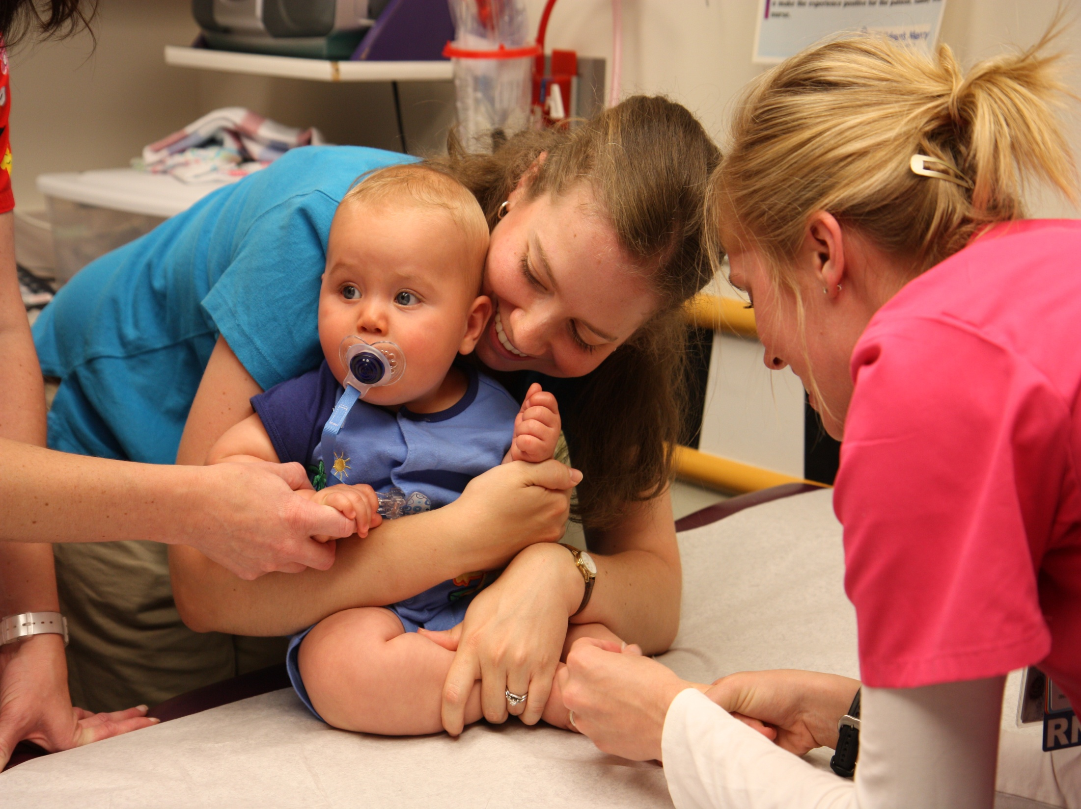
Guide to Comfort Holds

Slide 29
Goals When Using Comfort Holds
Successfully immobilize an extremity
Secure a comforting, hugging hold for child
Create close physical contact with the parent or caregiver
Sitting position that promotes a sense of control for the child and allows providers access to perform procedure
Table remains stable when the child moves
Reduce the required personnel resources to complete the procedure

Slide 30
Advantages
With appropriate holds, child is less able to move than with “burrito wrapping”
Parental participation in restraining the child gives the parent a constructive role in the procedure
Remaining close to parents helps decrease patient anxiety and reduces anxiety at future visits
Notes:
Until about 5-7 years, child is not coordinated enough to stiffen one arm and wiggle the other – therefore hugging stiffens both arms.

Slide 31
Research Support for Comfort Holds
Parental holding and upright positioning
Decreases distress in children
Increases parental satisfaction
Safe, simple, cost-effective measure that helps children and family cope
Sparks, L., Setlik, J., & Luhman, J. (2007) Parental holding and positioning to decrease IV distress in young children: A randomized controlled trial. Journal of Pediatric Nursing, 22, 440-447.

Slide 32
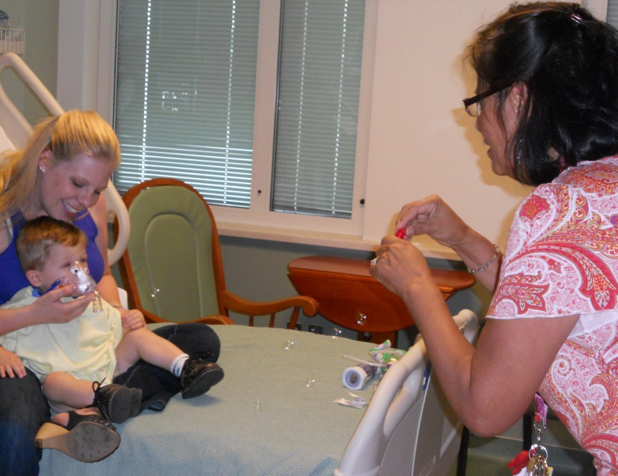
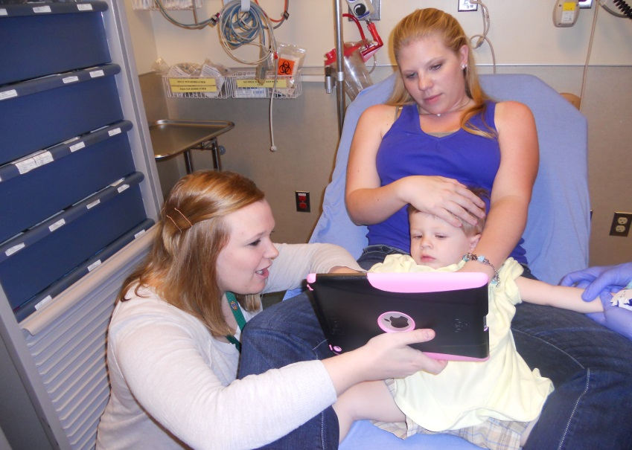
Infant/Toddler Back to Front (~6 mo – 6 yr)
Great for: oral exams, digital blocks, I&D procedures, fluorescein exams
Tips
For children who are fighting, have the parent sit on the bench and give the child a bear-hug with the child on their lap. You can pinch the child’s legs in the parent’s legs as needed
Notes:
infant digital block of toes

Slide 33
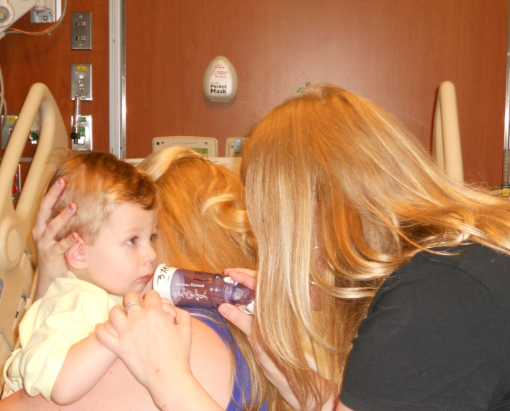
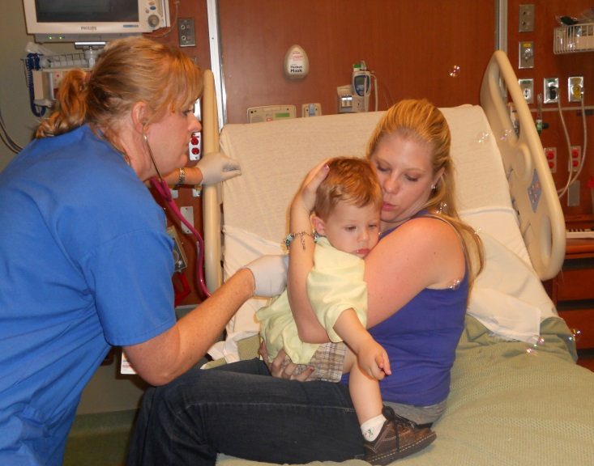
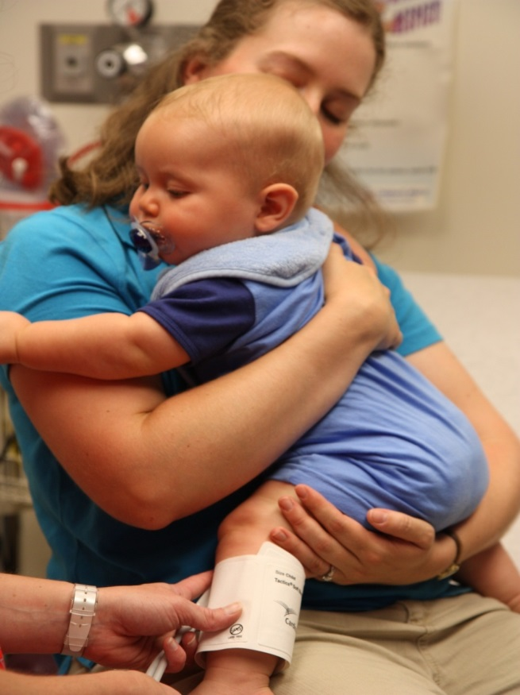
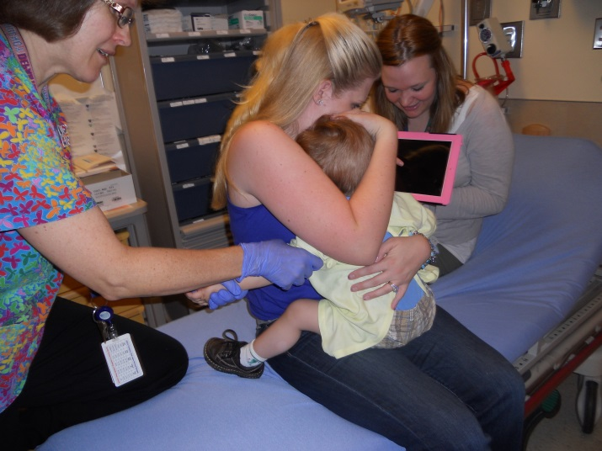
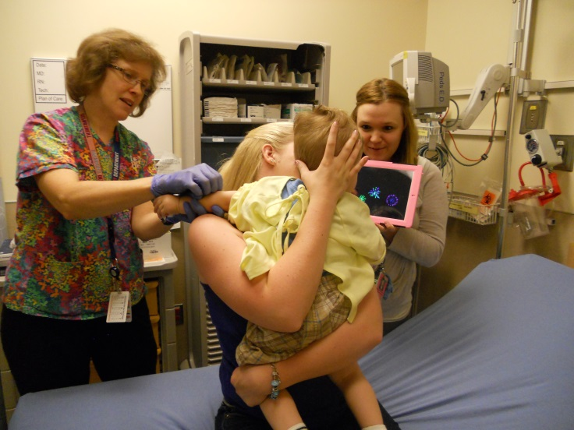
Infant/Toddler Front to Front (~ 6 mo – 6 yr)
Great for: respiratory exam, digital blocks, laceration repair with staples, I&D procedures

Slide 34
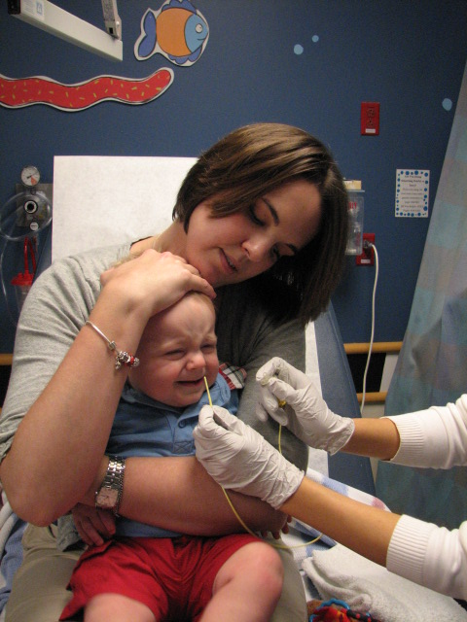
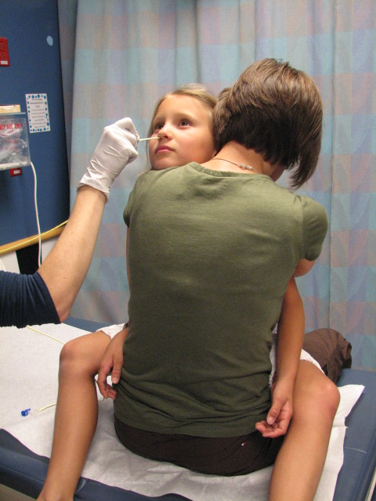
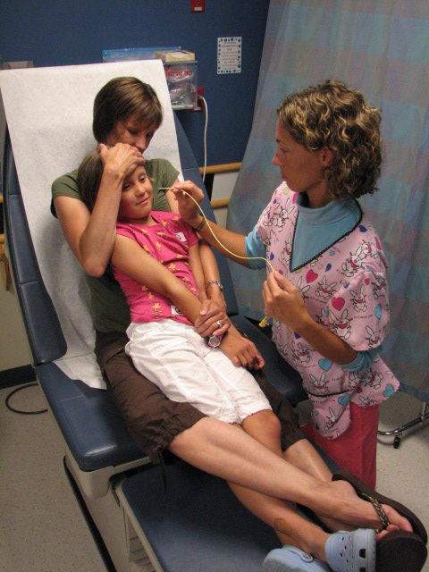
Front to Back Infant
Front to Front School Age
Front to Back School Age
Great for: staple procedures, digital blocks, foreign body removals
Great for: staple procedures, foreign body removals.
Great for: head laceration repairs (without parent holding head), foreign body removals.
Notes:
Front to back – leg between parents to minimize kicking;
1st- head lac repairs
2nd-
3rd-

Slide 35
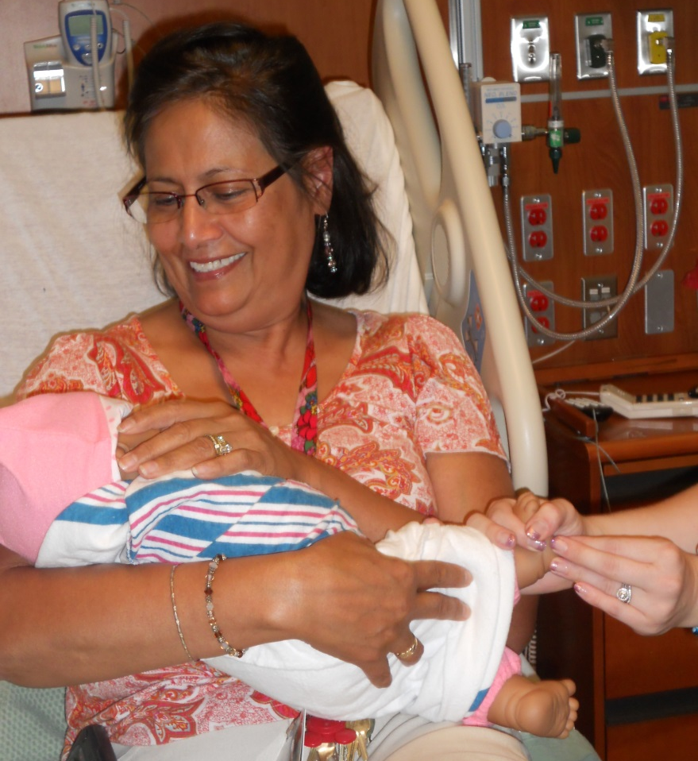
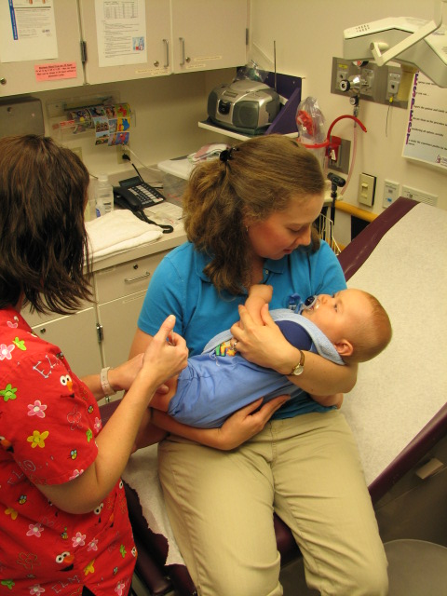
Infant Cradle (~< 6 mo)
Great for: digital blocks, I&D procedures, fluorescein exam.
Tips
For infants who are fussy and strong, swaddle the baby and leave the needed body-part exposed
Notes:
Initial assessment positioning, digital blocking, infant staple procedure

Slide 36
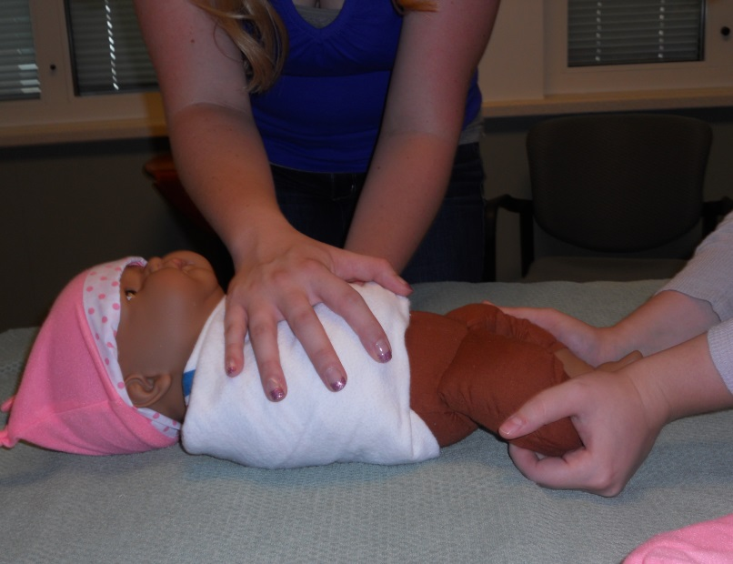
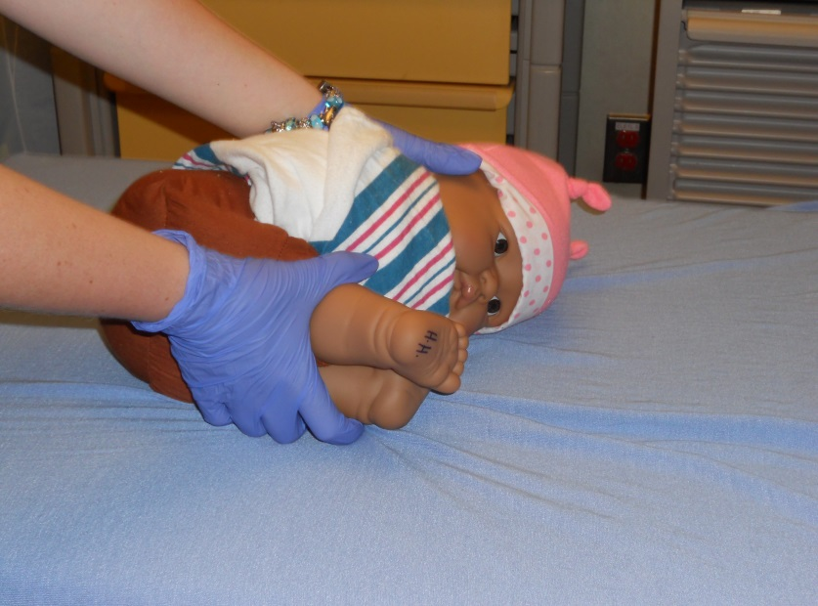
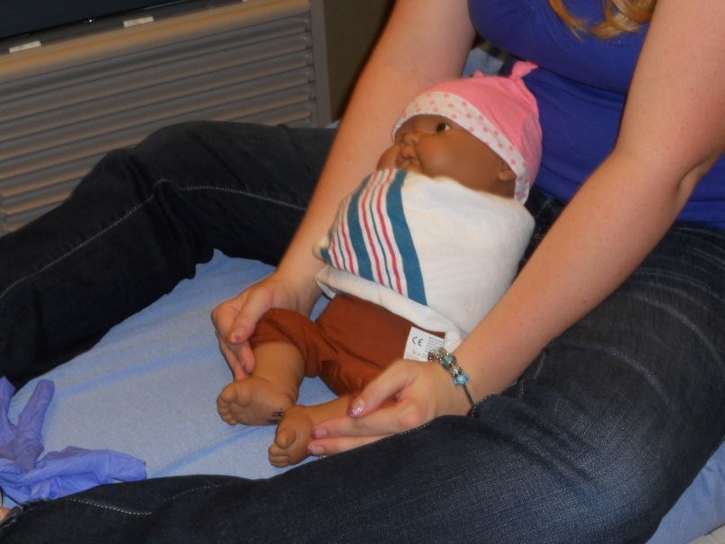
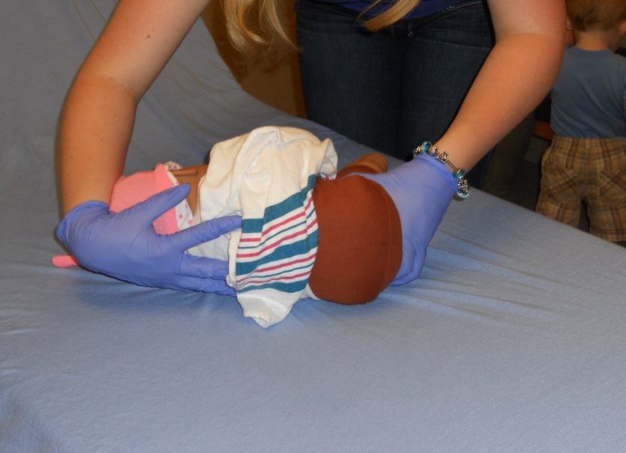
Infant “Top-Only” Swaddle (~< 6 mo)
Can be used for: LP’s, buttock abscess I&D, hair tourniquet removal

Slide 37
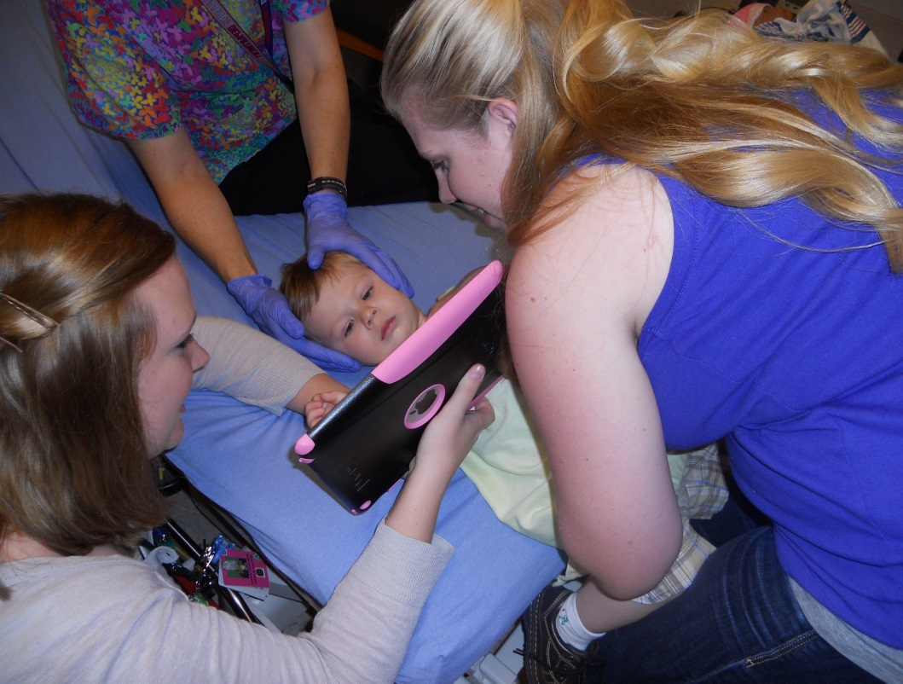
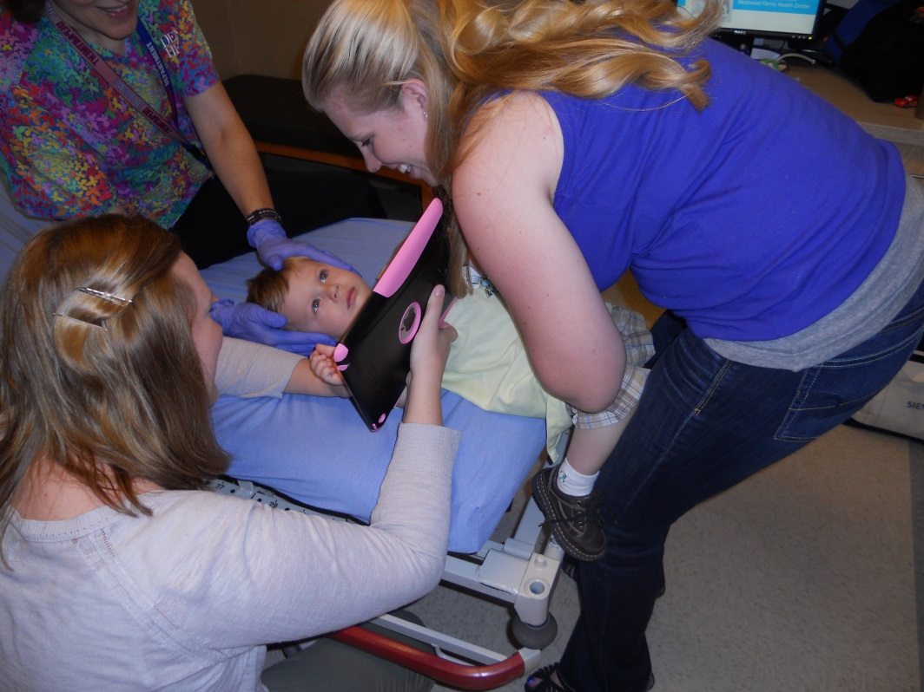
Front to Front lying down
Great for: facial sutures, arm/hand sutures, anterior leg sutures, nose/ear foreign body removal, very difficult ear exams.
Tips:
If the child is squirmy or the procedure is painful, raise the bed and have the parent lay forward on top of the child’s trunk while holding the child’s hands (this technique is like magic)

Slide 38
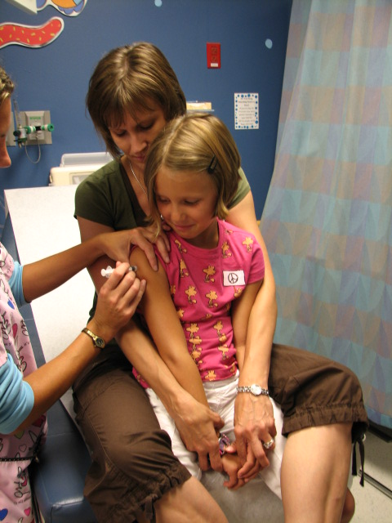
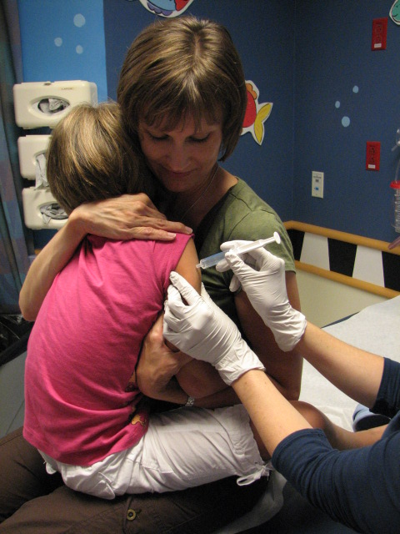
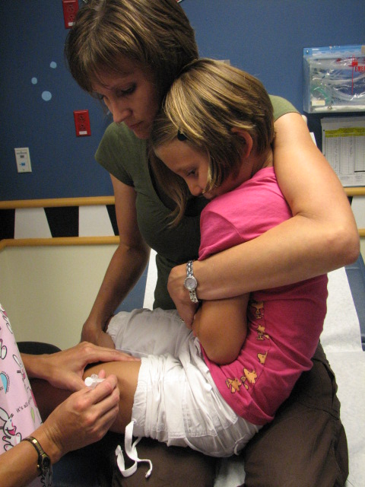
Front to Back School Age
Straddle School Age
Side Sit School Age
Great for: initial exams, laceration repair, digital blocks, initiation of procedural sedation

Slide 39
CHILD LIFE TIPS
Use child-friendly language when explaining procedures (especially ages 2-12)
Keep the parents as close to the child as possible and give them a “job” if you can
Make sure the parents are clear about what will happen and also that they are comfortable with the plan
Use distraction tools liberally
CALL Child Life for ALL procedures and difficult exams
Utilize one of the nurses if Child Life is not available.

Slide 40
Patient Updates/Tips for Communication
If it has been 1-2 hours since you last saw your patient, we expect you touch base with the family to tell them what they are waiting on.
Be careful telling the family what the plan is before staffing the patient, as sometimes it will change after talking to the attending.
Always ask the parents or patient “what they are most worried about” with the visit. This helps focus your counseling and also can uncover valuable clinical information.
Apologize for their wait (it always feels like a long wait, even if it isn’t).
Give time estimates that are about 2 times more than you think they will be (since we often underestimate how long things will take).
If parents are having a hard time conveying a coherent story or are telling you things that have no clinical relevance, stand-up and examine the patient to break up the discussion, then sit down and finish your history.

Slide 41
Patient Updates/Tips for Communication
When parents bring their child in for things that seem non-urgent, they are often trying to address one of a few basic needs or concerns:
Peace: parents can get overwhelmed by the needs of sick children
Common Chief Complaints: fussiness, abdominal pain, diarrhea, vomiting
Fear: parents often worry they will miss some horrible diagnosis (aka; cancer)
Common Chief Complaints: swollen lymph node, fatigue, polyuria, headache
Sleep: Similar to residents, parents are chronically sleep deprived and will do whatever it takes to get some sleep
Common Chief Complaints: coughing all night, fever, fussiness, abdominal pain
Guilt: Parents are frequently pressured by other “overly opinionated” family members to bring their child in to the ED
Common Chief Complaints: high fever, lymph nodes, prolonged cough, head injuries, not eating enough
*** When you ask parents what they are most worried about, you often uncover the motivation behind their visit. This can focus your counseling and speed up discharge.

Slide 42
Discharges
In order to discharge a patient the following things must be completed
Discuss plan to discharge patient with attending and then with patient/family.
Choose a “clinical impression” in the discharge navigator (ask the attending if you are unsure)
Write return precautions and follow up instructions

Slide 43
Discharges
In order to discharge a patient the following things must be completed
Choose Discharge Instructions (DCI’s) to add to the AVS (after visit summary)
Rx is signed by attending unless being E-prescribed (then placed on the physical chart).
Make sure you don’t exceed the adult max on meds and always have attending sign Rx unless you have your CO license and DEA.
Click “Discharge” under Disposition
DO NOT click discharge unless the patient could leave right now (aka; not waiting for meds, lab results, normal vitals, etc.)

Slide 44
Guide to Writing Good Return Precautions
Often we see return precautions written that are too general or too conservative.
Think about your DDx and what would happen to this patient if you are wrong about your presumed dx or what change in course would prompt you to change management.
If we think a 5 yo has a URI, the DDx includes heart failure and pneumonia. If the patient actually had one of these dx, they would start breathing faster in the next day, be listless in 1-2 days or have persistent fevers for 4-6 days total. If the URI became a LRTI with hypoxemia, the patient would breath faster and harder (prior to becoming cyanotic).
Do not tell patients to follow up with their PCP if the illness is self-resolving and there is no need for follow up tests (renal US for febrile UTI in young infants) or to change chronic meds (Flovent increase with asthma)

Slide 45
Follow Up
All results for pending labs (e.g. cultures or GC/ chlamydia testing) will automatically appear in an in-basket results folder monitored by the APPs and attendings.
Instruct families that “no news is good news” as we only call for results that are positive or require treatment.
If your patient needs urgent follow up in the Westside, Eastside, Web or Lowry clinics, please send an Epic message to the nurse in-basket in that clinic. The attendings can help show you how to do this.

Slide 46
Teaching
Board Rounds occur each day at 5pm. Rounds should be short <10 min and should review each patient on the board by stating dx and any interesting or relevant background to that dx (if it is a URI, just say URI and move on). The junior resident or student on the case should present the patient.
Each resident is expected to read one EBM article per week from the articles sent to you at the beginning of the month.
Sometimes the clinical flow is busy so most teaching is informal (not a presentation) and brief (1-2 pearls related to each case). This means it is your responsibility to ask attendings questions and learn at least one thing from each case you see.

Slide 47
Teaching
Seniors are expected to teach one “pearl” to junior residents for each case they staff.
Suture boards are located next to the Pediatrician’s desk. Please practice your suture techniques whenever you have down time and prior to “practicing” on live patients. Seniors residents should use the suture boards to assess the suturing skills of the junior residents prior to live patients.
Case conference occurs on the third Thursday of the month from 8:15-9am in the Peds conference room on the 2nd floor of the C pavilion. All residents working that week in the Pediatric Emergency Department and Urgent Care are expected to be there unless they were scheduled until midnight the night prior.

Slide 48
Sign-out
At the end of your shift you should signout your patients to another resident.
Residents who accept patients in signout should write a brief “Re-evaluation” note discussing the additional ED course of the patient and also an Assessment and Plan.
Peds or FM residents who initially staffed the patient with a Pediatrician AND who can only signout to an EM resident should discuss the transfer of care with the Pediatrician. Often the Pediatrician will assume primary care of the patient rather than co-manage the patient with the EM/PEM attending.
All residents are expected to be in the Pediatric Emergency Department and Urgent Care for their entire shift. Do not leave your shift early unless told to go home by an attending.

Slide 49
General Tips for Success in Interacting with Nursing
Introduce yourself to the RN’s you are working with (including name, year of training and specialty).
Try to tell nurses when you put in orders (especially urgent ones).
If you aren’t busy, consider completing your patient's rapid streps and starting ORT by giving popsicles/pedialyte/juice/Gatorade.
Always inform parents of invasive procedures and the plan of care BEFORE the RN goes in to complete the order (ie; blood draws, cath urines, strep swabs, ear irrigation).

Slide 50
General Tips for Success
Don’t forget to review lab/radiology results with patients and their parents.
Use child friendly language, interactions and child life as needed. Remember that the efficacy of oral meds is often equal to IM, and shots are not always necessary.
Kids take special handling and taking extra time or steps with them can save time and increase cooperation in the long run.
Oral preparation for amoxicillin is $0.04 plus $4 for RX- Injectable PCN cost at DH is $150.
Pay attention to age/condition when writing D/C orders.
No Motrin under 6 months.
Work as a team with your nurse to keep informed on the plan of care. Make a plan and order labs and meds at the same time.

Slide 51
Efficiency Tips From Attendings
Don’t batch admissions/discharges/notes. This is the least efficient way of doing things and often overloads nursing who can’t do 5 things simultaneously.
Tell your nurses (face to face) what needs to happen before the patient is able to go home.
Take <1 min to mentally “run the board” after each patient encounter to see what needs to be done next (check-lists are also helpful).
Set patient expectations for the ED course so you don’t have to go back in 5 times to update them or talk them down when they are frustrated.
Call the lab for all tests that aren’t back after 1 hour.

Slide 52
Efficiency Tips From Attendings
Anticipate what your patient is going to need based on CC and be prepared when you walk in the room (strep swab, US with pregnant patients, urine cup for dysuria, pelvic cart outside the room, etc). You will save way more time with the patients that end up needing it then the time you lose on those who don’t.
Treat pain and nausea aggressively and early. Mild belly pain or nausea can become somewhat worse and will delay discharge, so given ibuprofen and Zofran up front.
When you interview patients, ask questions that will actually change your management.
Plan as many steps ahead as you can and prepare paperwork for the next steps whenever you have a moment.

Slide 53
Thank You
All the providers and staff appreciate the hard work that residents give to serving our patients in the Denver Health Pediatric Emergency Department and Urgent Care. We take great pride in our department and are grateful for the passion, energy and inquisitiveness that accompanies the residents who rotate with us.
We hope you have a great experience and learn a lot while you are here.
For any questions or concerns you have, please contact either
Patti Ziegler (Administrative Assistant) for all general questions or questions regarding the schedule
patricia.ziegler@dhha.org
Phone: 303-602-5151
OR
Matt Rustici MD (Resident Education Director)
Matthew.rustici@ucdenver.edu
Cell: 720-670-9024

